Slide 1
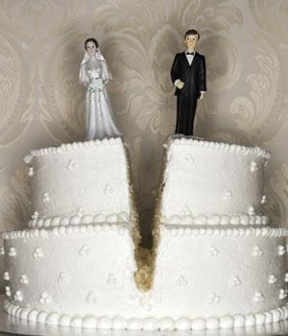
When You Say "I Don't"
Matthew 5:31-32
Dr. Rick Griffith, Crossroads International Church
BibleStudyDownloads.org

Slide 2
Black on White
Notes:
Don't you just love talking to children? I do.

Slide 3
Kids on Marriage
Notes:
Researchers have discovered that kids have interesting views on marriage. This is evident in their answers to some basic questions, such as…

Slide 4
How Does a Person Decide Who to Marry?

Slide 5
"You got to find somebody who likes the same stuff. Like if you like sports, she should like it that you like sports, and she should keep the chips and dip coming." Allan, age 10

Slide 6
"No person really decides before they grow up who they're going to marry.
…God decides it all way before, and you got to find out later who you're stuck with." Kirsten, age 10

Slide 7
How Can a Stranger Tell if Two People are Married?

Slide 8
"Married people usually look happy to talk to other people." Eddie, age 6

Slide 9
"You might have to guess based on whether they seem to be yelling at the same kids." Derrick, age 8

Slide 10
What Do Most People Do on a Date?

Slide 11
"Dates are for having fun, and people should use them to get to know each other. Even boys have something to say if you listen long enough." Lynnette, age 8

Slide 12
"On the first date, they just tell each other lies, and that usually gets them interested enough to go for a second date." Martin, age 10

Slide 13
The Great Debate: Is It Better to Be Single or Married?

Slide 14
"It's better for girls to be single but not for boys. Boys need somebody to clean up after them!" Anita, age 9

Slide 15
Do you personally defend marriage?
Notes:
These kids don't seem to be great at defending marriage. How about you? Do you personally defend marriage?

Slide 16
As marriage goes…

Slide 17
…so goes the family...

Slide 18
Her scars are on the inside…

Slide 19
…as the family goes...

Slide 20
…so goes the entire world.

Slide 21
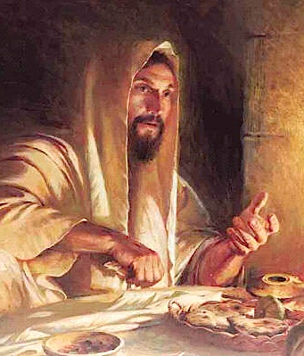
Jesus, though single, saw the priority of marriage
Notes:
Although single, Jesus knew that the state of marriage is the single most important human relationship.
Therefore, when marriage was attacked, we will see today that Jesus was quick to come to its defence.

Slide 22
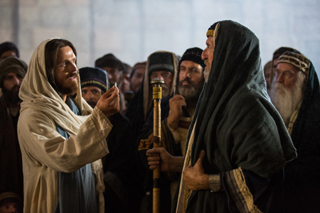
Jesus confronted the Pharisees
Notes:
Most Jewish teachers of Jesus' day influenced first-century Jews to justify divorce for many silly reasons

Slide 23
Back to Basics (Matt. 5:21-48)
"You have heard that it was said…"
6 Issues:
"But I tell you…"
Murder
Adultery
Divorce
Vows
Revenge
Enemies
God's True Intent
Pharisee Teaching
External purity won't enter the kingdom (20)
Notes:
Here we see how "Jesus rejected the traditions of the Pharisees (vv. 21-48) … Six times Jesus said, "You have heard that it was said. ... But I tell you" (5:21-22, 27-28, 31-32, 33-34, 38-39, 43-44). These words make it clear that Jesus was presenting (a) what the Pharisees and teachers of the Law were saying to the people and, by contrast, (b) what God's true intent of the Law was. This spelled out His statement (v. 20) that Pharisaic righteousness is not enough to gain entrance into the coming kingdom" (Barbieri, BKC, 2:30).

Slide 24
Marriage is in trouble today.

Slide 25
I want the kind of marriage that makes my kids want to get married.

Slide 26
Singles, don't tune out.

Slide 27
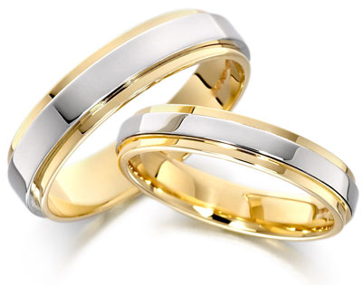
How can you defend marriage?
• 2 ways
• Matthew 5:31-32
Notes:
We know that God has a high view of marriage, but how can you defend marriage?
• Today we will see two ways we can defend marriage like Jesus.
• The two verses of Matthew 5:31-32 are among the most important verses in the Bible on marriage.
So what's the first way that you can defend marriage?

Slide 28
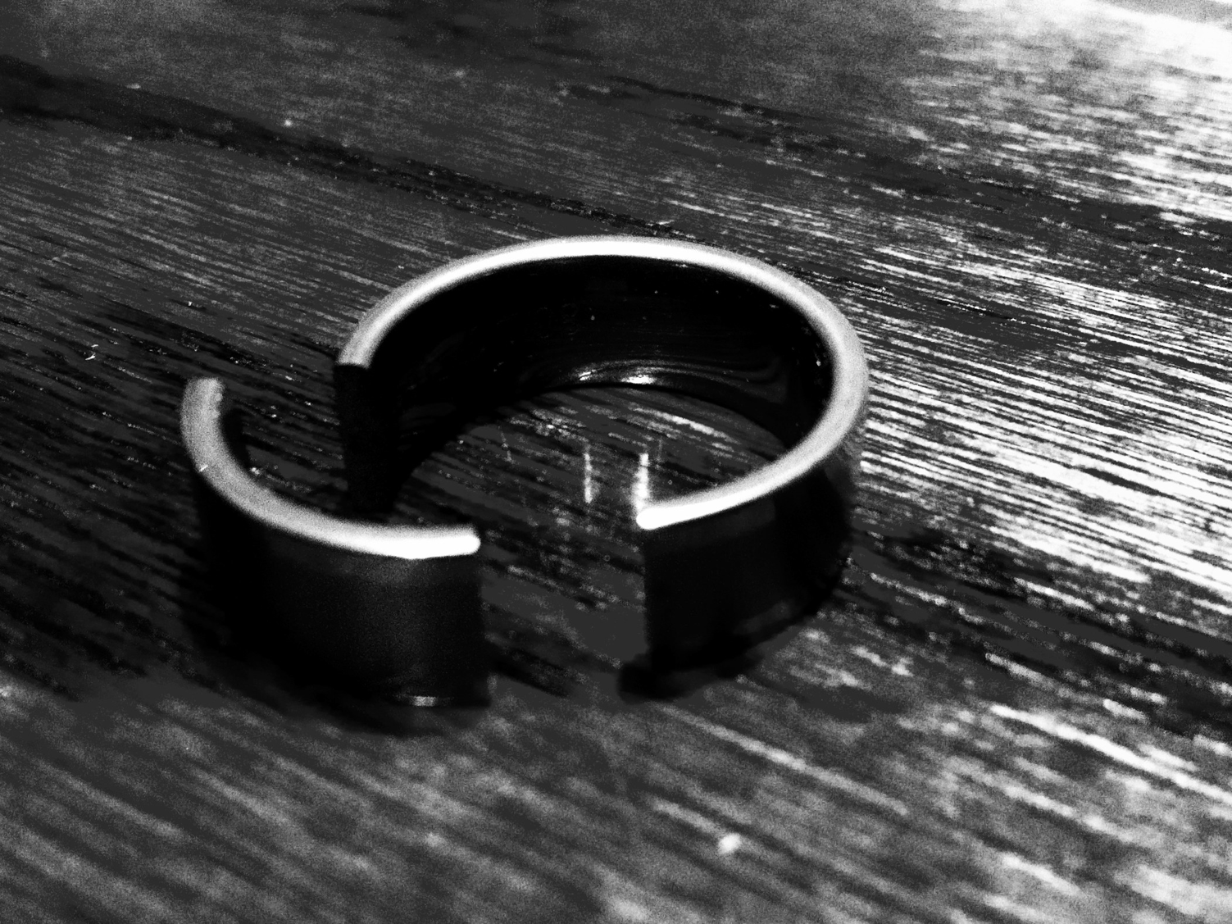
I. Don't let marriage be devalued (Matt 5:31).

Slide 29
Jewish leaders attacked marriage by supporting frivolous divorce (Matt 5:31).

Slide 30
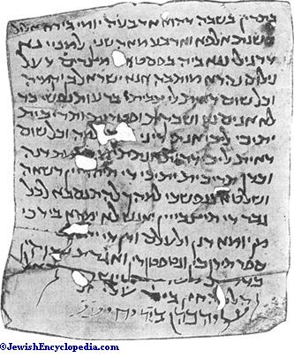
"You have heard the law that says, 'A man can divorce his wife by merely giving her a written notice of divorce'" (Matt 5:31 NLT).
Notes:
The main OT stipulation on marriage was the command that a man divorcing his wife had to give her a written certificate of divorce (Deut. 24:1). But why was this commanded?

Slide 31
Did Deuteronomy 24:1 just leave the divorced woman alone?
Notes:
Some societies think so poorly of women (and marriage) that a simple verbal declaration of divorce dissolves the marriage. This leads to ambiguity on whether a man said it, which persons heard it as witnesses, and a host of other problems. The result was that some wives did not even know if they were married anymore!

Slide 32
The Right to Remarriage Guaranteed
“You are free to marry any [Jewish] man you wish”

Slide 33
What About Remarriage?
Read the small print. Read an actual divorce certificate from around the time of Christ.
—A Jewish divorce certificate says:
"You are now free to marry anyone you wish."
—Divorce certificates have much more, but these are the only necessary words.
—In other words, the essence of the divorce certificate was the right to remarry
(slideshare.com)

Slide 34
Rabbinic Grounds for Divorce?
School of Hillel
School of Shammai
Liberal
Conservative
Divorce for any reason
Divorce Only for adultery
Notes:
Pharisees used this OT protection to justify their frivolous divorces (Matt 5:31b).

Slide 35
"Some Pharisees came and tried to trap him with this question: 'Should a man be allowed to divorce his wife for just any reason?'" (Matt 19:3 NLT)
Notes:
Later, in Matthew 19, the leaders put the question to Jesus which school he favored. But here in Matthew 5 Jesus brings the issue up himself and turns the tables on not upholding divorce but upholding marriage.

Slide 36
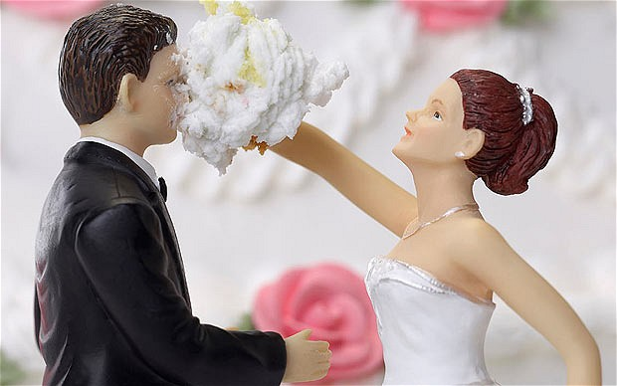
We must defend marriage today from attacks.

Slide 37
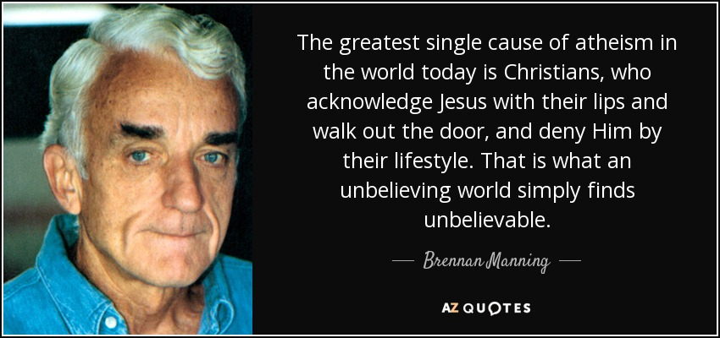
Lip Service
"The greatest single cause of atheism in the world today is Christians, who acknowledge Jesus with their lips and walk out the door, and deny him by their lifestyle. That is what an unbelieving world simply finds unbelievable."
—Brennan Manning—

Slide 38
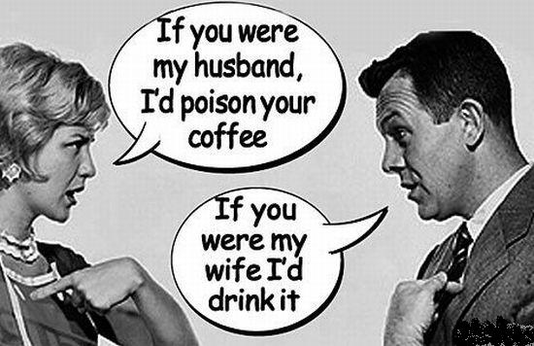
Watch your talk.
If you were my husband, I’d poison your coffee
If you were my wife, I’d drink it

Slide 39
Teach True Marriage

Slide 40
What is Marriage?

Slide 41
Side

Slide 42
"No Fault Divorce"

Slide 43
Mutuality in Marriage
Notes:
Some teach that Christian marriage is the husband as king and the wife as slave.
Tell them that it is more like the difference between the Prime Minister and the President.

Slide 44
How can you defend marriage?
• 2 ways
Notes:
We know that God has a high view of marriage, but how can you defend marriage?
So what's the first way that you can defend marriage?

Slide 45
I. Don't let marriage be devalued (Matt 5:31).
Notes:
Don't let it be devalued, but now we see one of the most important ways to preserve it in the next verse…

Slide 46
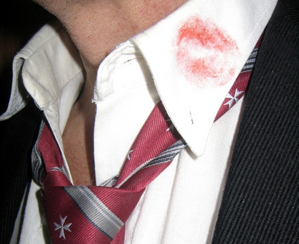
II. Defend marriage against adultery (Matt 5:32).
Notes:
The way to preserve the marital union is by keeping sex within marriage.

Slide 47
"But I say that a man who divorces his wife, unless she has been unfaithful, causes her to commit adultery" (Matt 5:32a NLT).
Notes:
Jesus defended marriage by prohibiting divorce unless promiscuity had led to adultery (Matt 5:32).
When Jesus said, "But I say…" was he disagreeing with the OT (32a)?
No, Jesus didn't actually contradict the Scripture.
What Jesus did was to prohibit the Pharisees from using a law that managed divorce in order to encourage divorce.

Slide 48
Jesus honored marriage by declaring that divorce also leads to adultery for the person who marries the divorcee (Matt 5:32b)

Slide 49
How does a man divorcing his wife cause her to commit adultery (32b)?
Notes:
God made marriage for life and considers us married to our spouse until death. The only exception is when there exists a biblically allowed divorce.
Without such a God-approved reason for divorce, a woman who remarries (which is assumed she will do) commits adultery since she is—in the sight of God—still married to her first husband.

Slide 50
What is porneia?
”…a man who divorces his wife, unless she has porneia, causes her to commit adultery” (Matt 5:32a).

Slide 51
What is porneia?
"unfaithful" (NLT, NIV)
"fornication" (KJV)
"unchastity" (NAS)
"immorality" (ESV, NET)

Slide 52
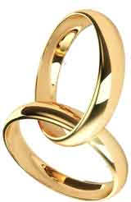
The Vow
"I, [name], take you [name], to be my [husband/wife], to have and to hold from this day forward, for better or for worse, for richer, for poorer, in sickness and in health, to love and to cherish; from this day forward until death do us part."

Slide 53
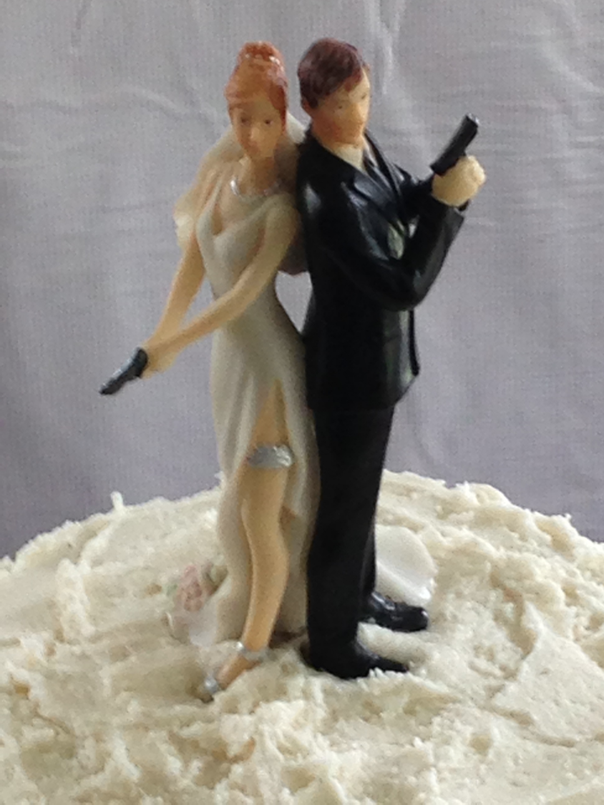
Porneia refers to any sexual sin that violates the vow made at marriage

Slide 54
"And anyone who marries a divorced woman also commits adultery" (Matt 5:32b NLT).
Notes:
In God's opinion—which is the one that matters most—a woman who is not legitimately divorced is obviously still married to her first husband.
That means that a second man who has sex with her becomes an adulterer, as he enters into a sexual relationship with another man's wife.

Slide 55
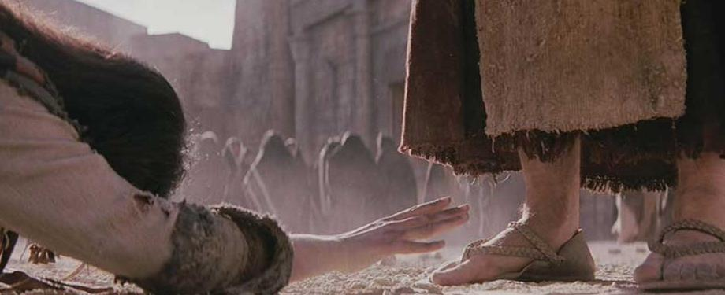
Does the adultery here refer to a constant state of perpetual adultery or a single act of adultery?
Notes:
It argues more than the text is saying to refer to this as a continual state of adultery.
The idea is that this first sexual act is adulterous. However, it seems to me that subsequent sex is not deemed adulterous to God.

Slide 56
We need to help marriages in trouble.

Slide 57
Virgins Until Marriage
how women who waited feel about their choice

Slide 58
Fornication Rate in USA
100%
Source: USA Today
95%
1%
0%
1900
2002
Notes:
Most Americans have had premarital sex, study finds Updated 12/19/2006 9:29 PM ET
usatoday30.usatoday.com/news/health/2006-12-19-premarital-sex_x.htm
Accessed 29 Feb 2016

Slide 59
Song of Songs
425
Exercise premarital sexual restraint so that marriage can be enjoyed to its fullest (i.e., allow love to blossom in its own time).
“Do not arouse or awaken love until it so desires” (2:7b NIV).
“Do not arouse or awaken love until it so desires” (3:5b NIV).
“Do not arouse or awaken love until it so desires” (8:4b NIV).

Slide 60
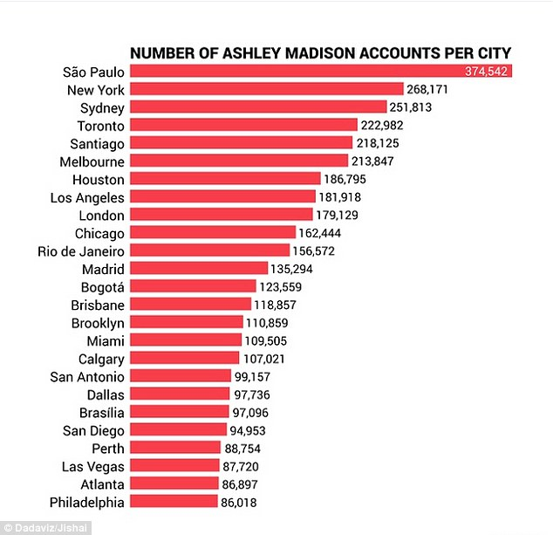
Number of Accounts Per City
Over 20,800,000 anonymous members to a website to facilitate adultery

Slide 61
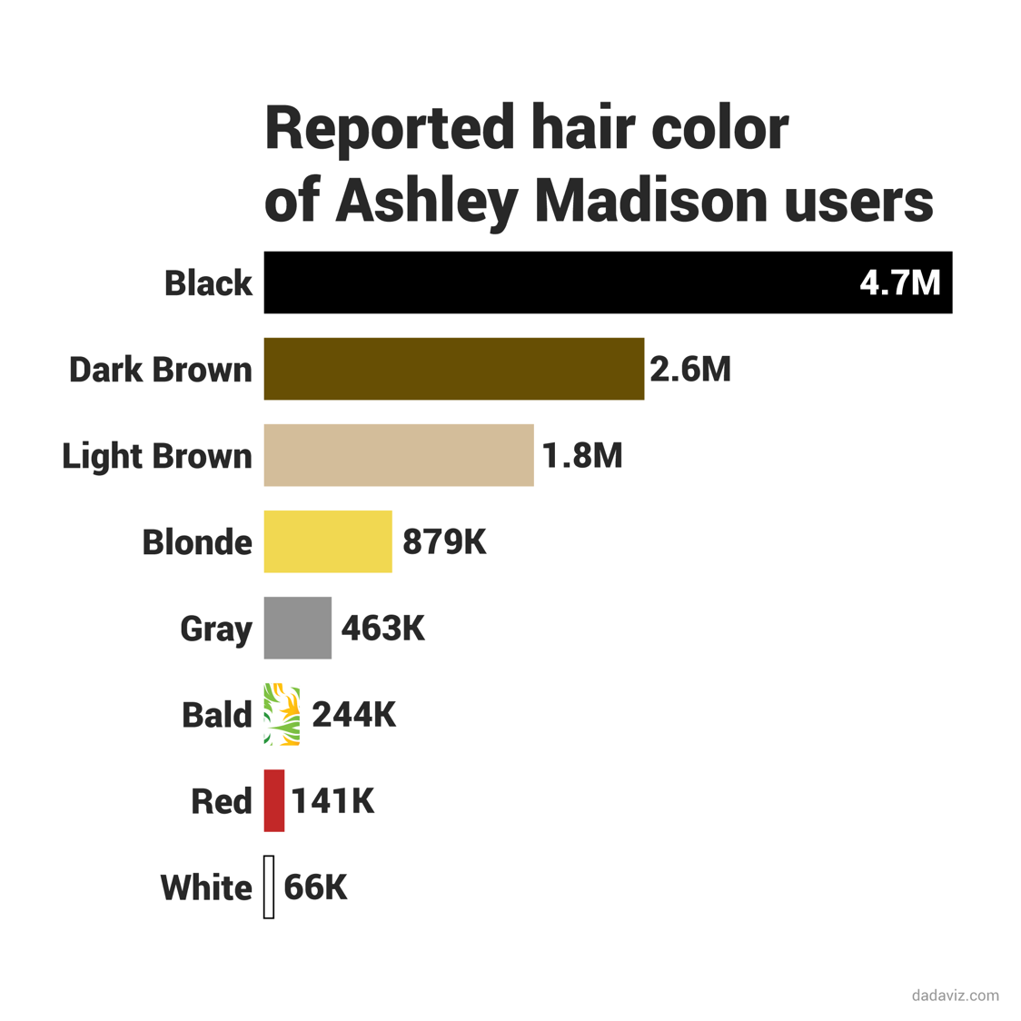
Reported Hair Color of Adultery Website Users

Slide 62
"The one who commits adultery with a woman is lacking sense; He who would destroy himself does it. Wounds and disgrace he will find, and his reproach will not be blotted out" (Prov. 6:32-33).

Slide 63
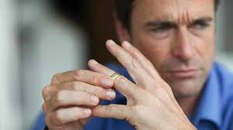
"Dear friends, I urge you to abstain from sinful desires, which wage war against your soul" (1 Peter 2:11 ).
Put safeguards in your own marriage to guard your own purity

Slide 64
Adultery
"Adultery occurs in the head long before it occurs in the bed."
— Chuck Swindoll

Slide 65
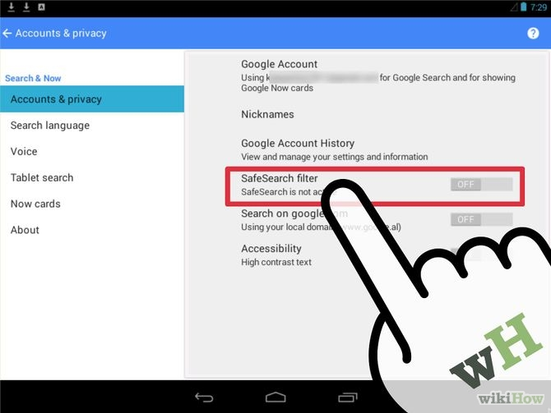
Google Safe Search

Slide 66
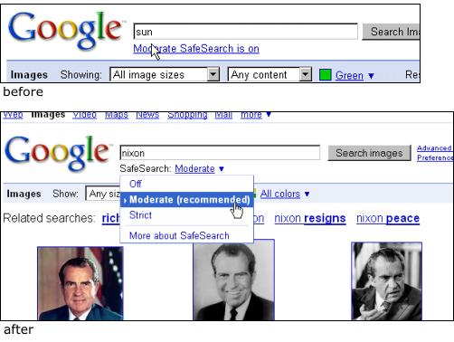
Use Strict Filter

Slide 67
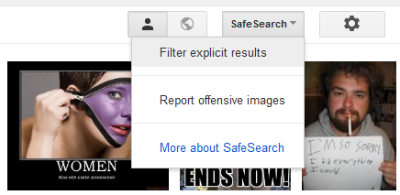
Train Your Computer

Slide 68
Nurture Relationships with those of Your Own Sex

Slide 69
Nurture Relationships with those of Your Own Sex

Slide 70
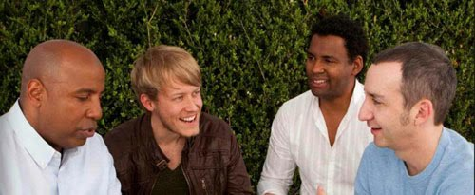
Nurture Relationships with those of Your Own Sex

Slide 71
How can you defend marriage?
• 2 ways
Notes:
We know that God has a high view of marriage, but how can you defend marriage?
So what's the first way that you can defend marriage?

Slide 72
Guard against divorce.
Main Idea

Slide 73
I. Don't let marriage be devalued (Matt 5:31).
Notes:
Don't let it be devalued, but now we see one of the most important ways to preserve it in the next verse…

Slide 74
II. Defend marriage against adultery (Matt 5:32).
Notes:
The way to preserve the marital union is by keeping sex within marriage.

Slide 75
Success in marriage is the sum of small efforts, focused on showing love and appreciation, repeated every day.

Slide 76
NT Sermons link at biblestudydownloads.org
Get this presentation and script for free!

Slide 77
Black

